Slide 1
Optimization of X-ray Backlighter Sources as Diagnostics for Ion-Heated Matter
42nd PHEDM “Hirschegg” Workshop
Philipp Hesselbach
Notes:
0:30

Slide 2

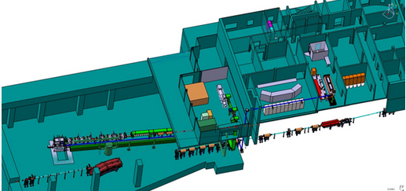
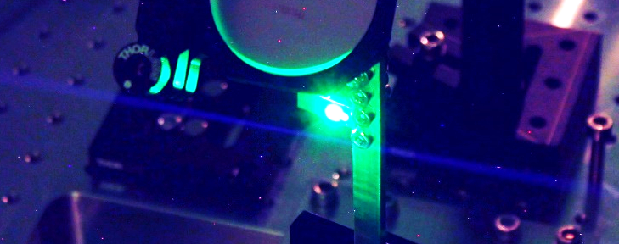
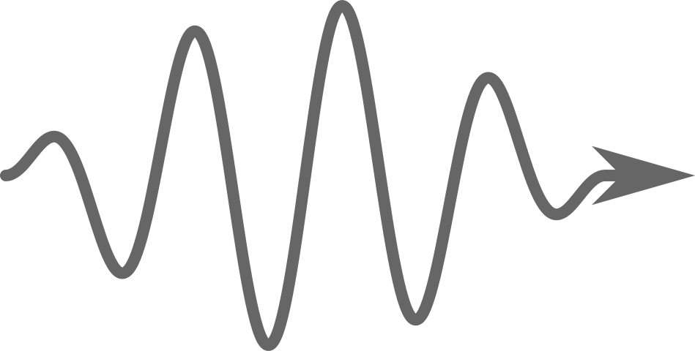
Combined Laser-Ion Experiments Enabled at HHT and Relevant for FAIR
GSI Infrastructure: HHT cave*
FAIR Infrastructure: APPA cave**
Picture by B. Zielbauer
SIS-18 ion beam
PHELIX laser
Ion beam
Sample
Laser
X-rays
Detector
Target
*Zs. Major‘s talk (Monday)
**S. Neff‘s talk (Monday)
Notes:
1:00 (1:30)

Slide 3
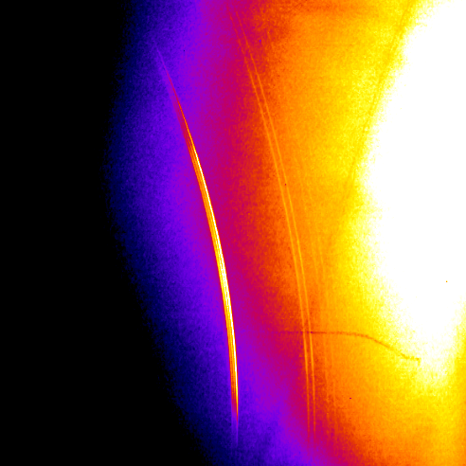
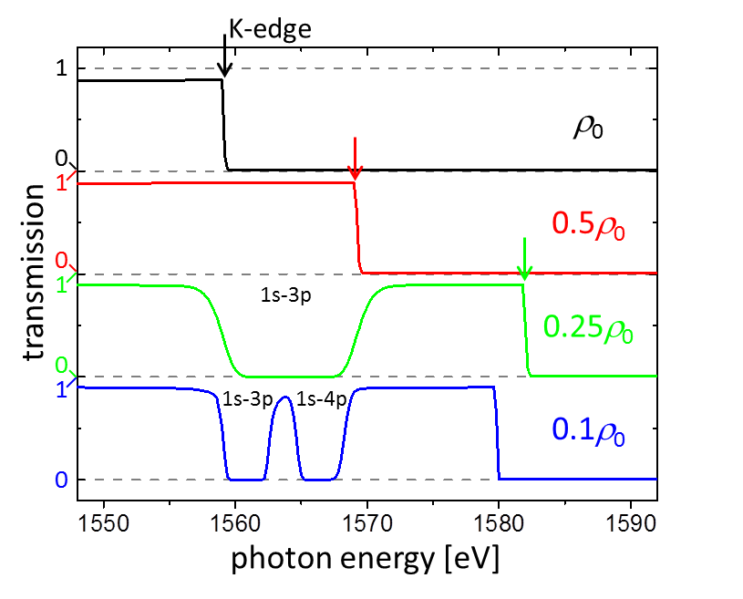
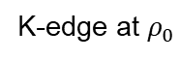
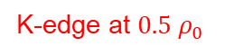
Line Emission and Spectrally Broad X-Ray Sources for Different Diagnostics
Detector
Ion beam
Sample
Laser
X-rays
Detector
Target
Results for cold samples
Various Diagnostic Methods
X-ray diffraction */**
(111)-reflection
(diamond)
FLYCHK simulation of Al
→D. Riley (Monday)
→D. Kraus (Monday)
K-edge at $ρ_{0}$
transmission
K-edge at $0.5 ρ_{0}$
photon energy [eV]
*D. Riley‘s talk (Monday)
**D. Kraus‘ talk (Monday)
He_{α}
He_{β}
He_{γ}
Notes:
2:45 (4:15)
diagnostics -> source
lattice structure of a crystal
only cold samples
Shortly: XRD, Radiography
(detect constructive interference of Bragg reflected X-rays)

Slide 4
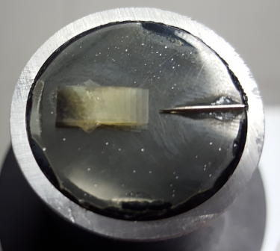
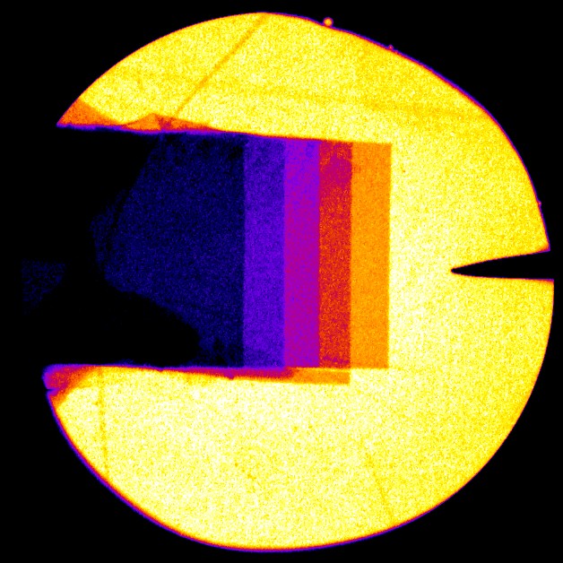
Line Emission and Spectrally Broad X-Ray Sources for Different Diagnostics
Ion beam
Sample
Laser
X-rays
Detector
Target
Results for cold samples
Various Diagnostic Methods
X-ray diffraction */**
X-ray radiography
FLYCHK simulation of Al
→D. Riley (Monday)
→D. Kraus (Monday)
Radiograph
Test object
K-edge at $ρ_{0}$
transmission
K-edge at $0.5 ρ_{0}$
2mm
photon energy [eV]
step wedge
(polycarbonate)
needle
(steel)
*D. Riley‘s talk (Monday)
**D. Kraus‘ talk (Monday)
Zs. Major et al., GSI HED Report, 2019
Notes:
2:45 (4:15)
diagnostics -> source
lattice structure of a crystal
only cold samples
Shortly: XRD, Radiography
(detect constructive interference of Bragg reflected X-rays)

Slide 5
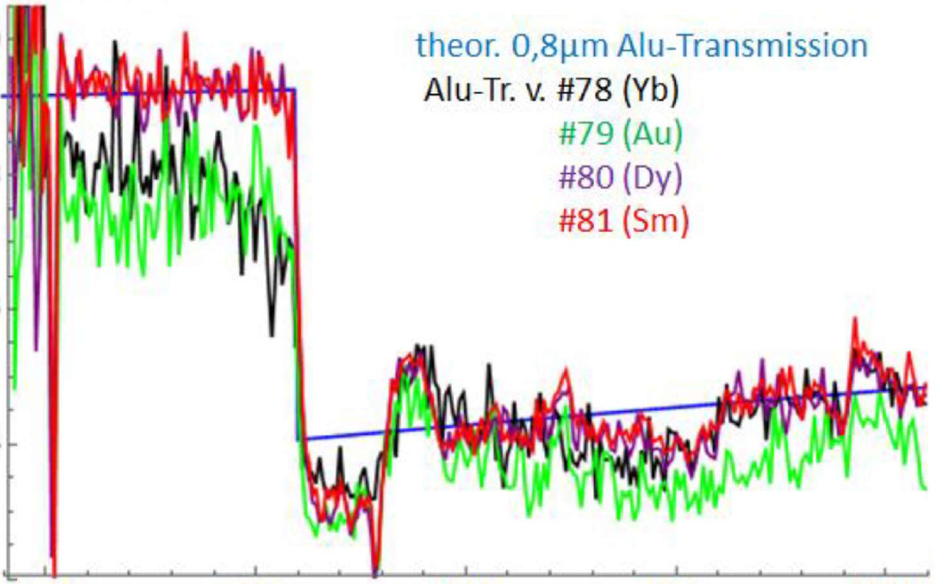
Line Emission and Spectrally Broad X-Ray Sources for Different Diagnostics
Ion beam
Sample
Laser
X-rays
Detector
Detector
Target
Results for cold samples
Various Diagnostic Methods
X-ray diffraction */**
X-ray radiography
X-ray absorption spectroscopy, e.g. X-ray absorption near edge structure (XANES)
…
XANES of 0.8μm Alu
FLYCHK simulation of Al
→D. Riley (Monday)
→D. Kraus (Monday)
1.0
Data from CXRO
K-edge at $ρ_{0}$
0.8
Transmission
transmission
K-edge at $0.5 ρ_{0}$
0.6
K-shell ionization edge of Al
0.4
photon energy [eV]
→short range order
*D. Riley‘s talk (Monday)
**D. Kraus‘ talk (Monday)
1500
1550
1600
1650
1700
Energy [eV]
H. Karadas, GSI, 2019
Notes:
2:45 (4:15)
diagnostics -> source
lattice structure of a crystal
only cold samples
Shortly: XRD, Radiography
(detect constructive interference of Bragg reflected X-rays)

Slide 6
Line Emission and Spectrally Broad X-Ray Sources for Different Diagnostics
Laser
X-rays
Target
Various Diagnostic Methods
X-ray diffraction */**
X-ray radiography
X-ray absorption spectroscopy, e.g. X-ray absorption near edge structure (XANES)
…
X-ray source demands
FLYCHK simulation of Al
→D. Riley (Monday)
→D. Kraus (Monday)
Line emission from x-ray source
K-edge at $ρ_{0}$
Spectrally broad x-ray source
transmission
K-edge at $0.5 ρ_{0}$
photon energy [eV]
*D. Riley‘s talk (Monday)
**D. Kraus‘ talk (Monday)
Notes:
2:45 (4:15)
diagnostics -> source
lattice structure of a crystal
only cold samples
Shortly: XRD, Radiography
(detect constructive interference of Bragg reflected X-rays)

Slide 7
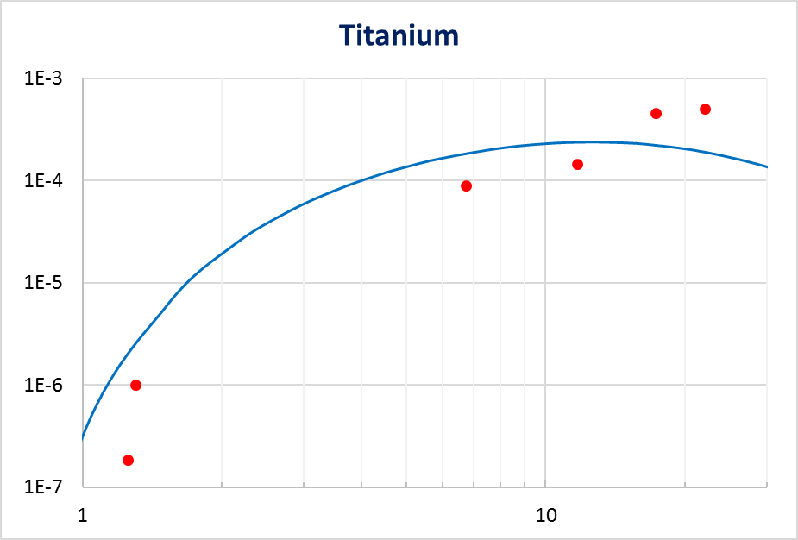

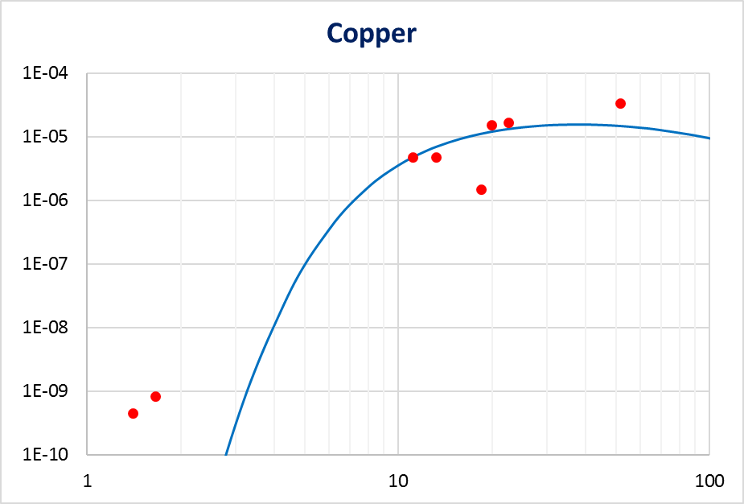
Increase of Photon Energies from Line Emission Necessary for Thicker Samples
X-ray diffraction
Exp. campaign at PHELIX
1e-3
₂₂Ti: E_{ph} = 4.8 keV
Typical creation of x-ray line emission
High-energy ns-laser (PHELIX: 200J) focused on mid-Z target (e.g. ₂₂Ti)
Plasma with T_{e}∼ keV electrons
Line emission, in particular He_{α}
Conv. Eff. dropping with Z
Sufficiently high photon numbers only for ≲ 10 keV
He_{α} line
1e-4
Z
1e-5
Model fit
1e-6
1e-7
1
10
E(He_{α})/E_{Laser}
Intensity in 1e14 W/cm²
1e-4
₂₉Cu: E_{ph} = 8.4 keV
1e-5
1e-6
1e-7
1e-8
1e-9
1e-10
1
10
100
L. Geiger, GSI, 2019
Intensity in 1e14 W/cm²
Notes:
3:15 (7:30)
Shortly: Photon Energy <-> Thickness

Slide 8
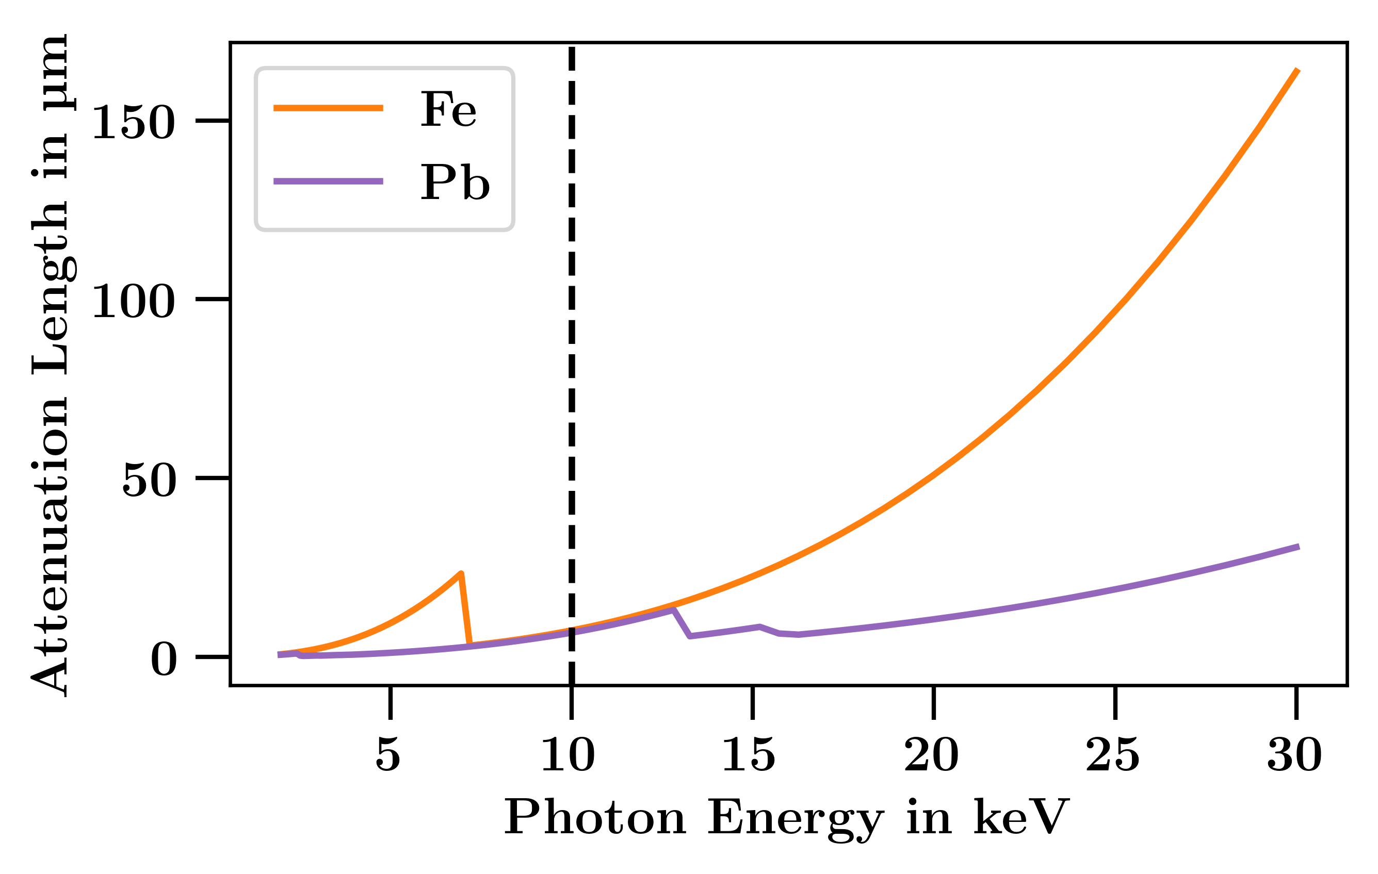
Increase of Photon Energies from Line Emission Necessary for Thicker Samples
X-ray diffraction
X-ray diffraction
Detector
Typical creation of x-ray line emission
High-energy ns-laser (PHELIX: 200J) focused on mid-Z target (e.g. ₂₂Ti)
Plasma with T_{e}∼ keV electrons
Line emission, in particular He_{α}
Conv. Eff. dropping with Z
Sufficiently high photon numbers only for ≲ 10 keV
Higher photon energies necessary for thicker samples
Idea: Additional generation of fast electrons >10 keV → higher Z possible
He_{α} line
Ion beam
Sample
Laser
X-rays
Z
Target
(Data from CXRO)
Notes:
3:15 (7:30)
Shortly: Photon Energy <-> Thickness

Slide 9

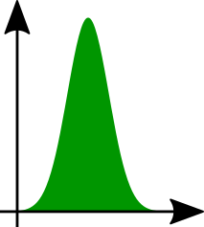

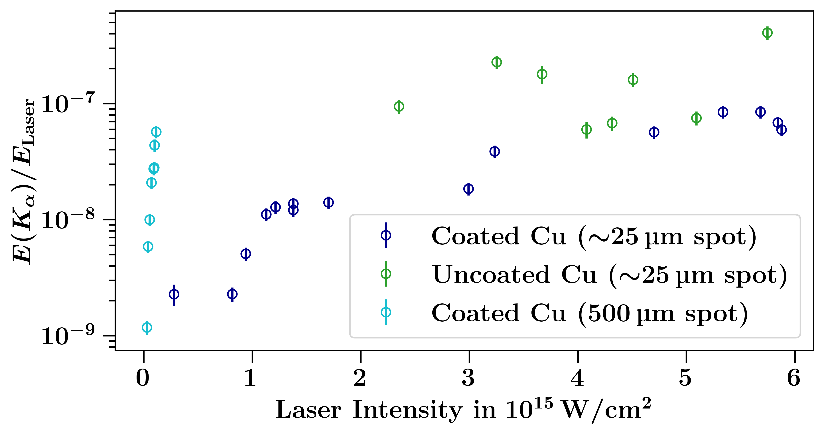
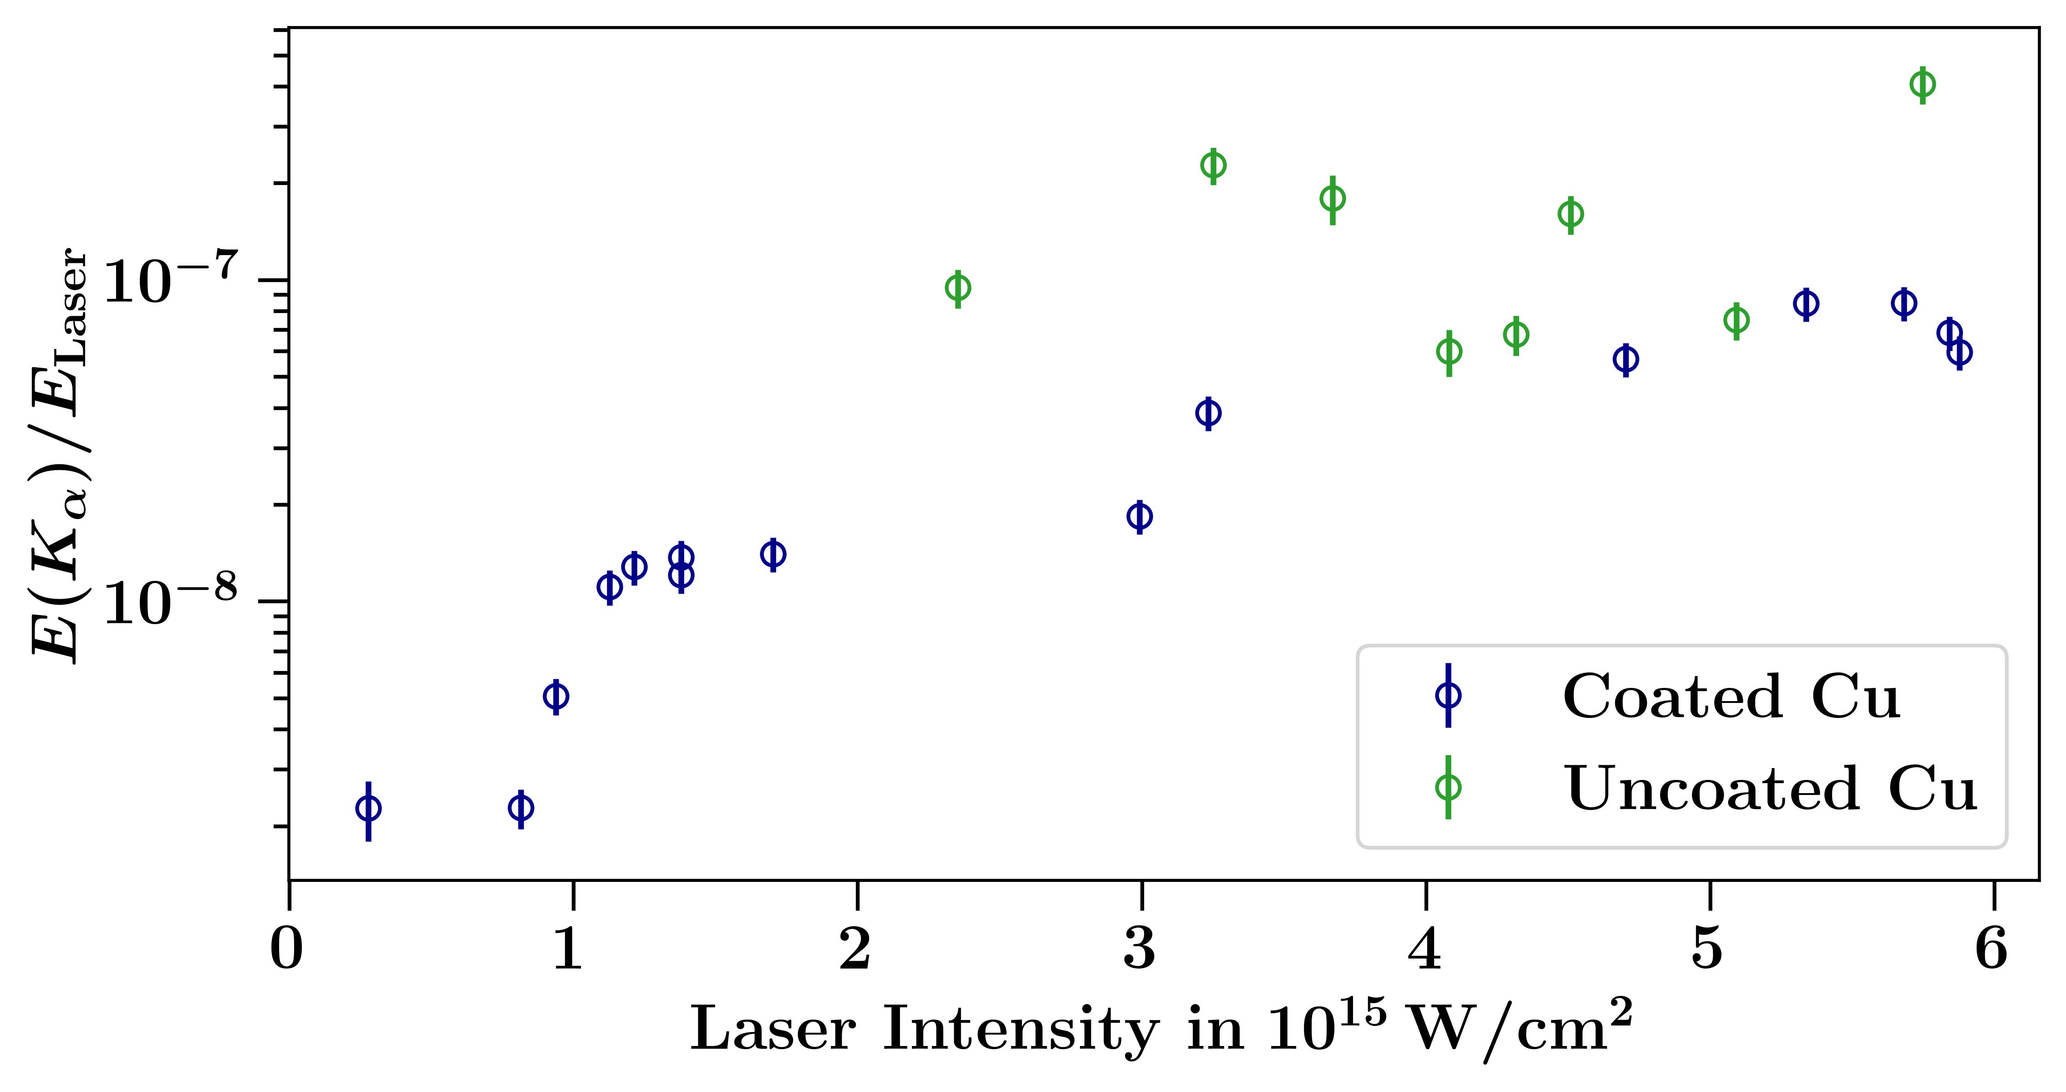
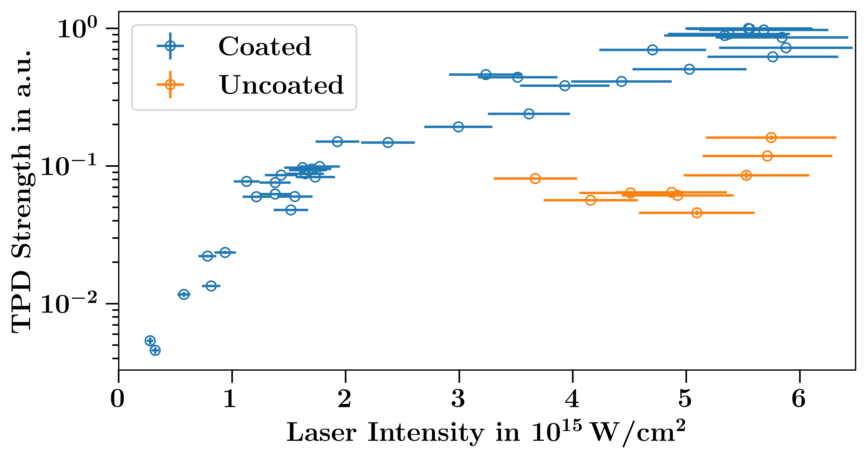
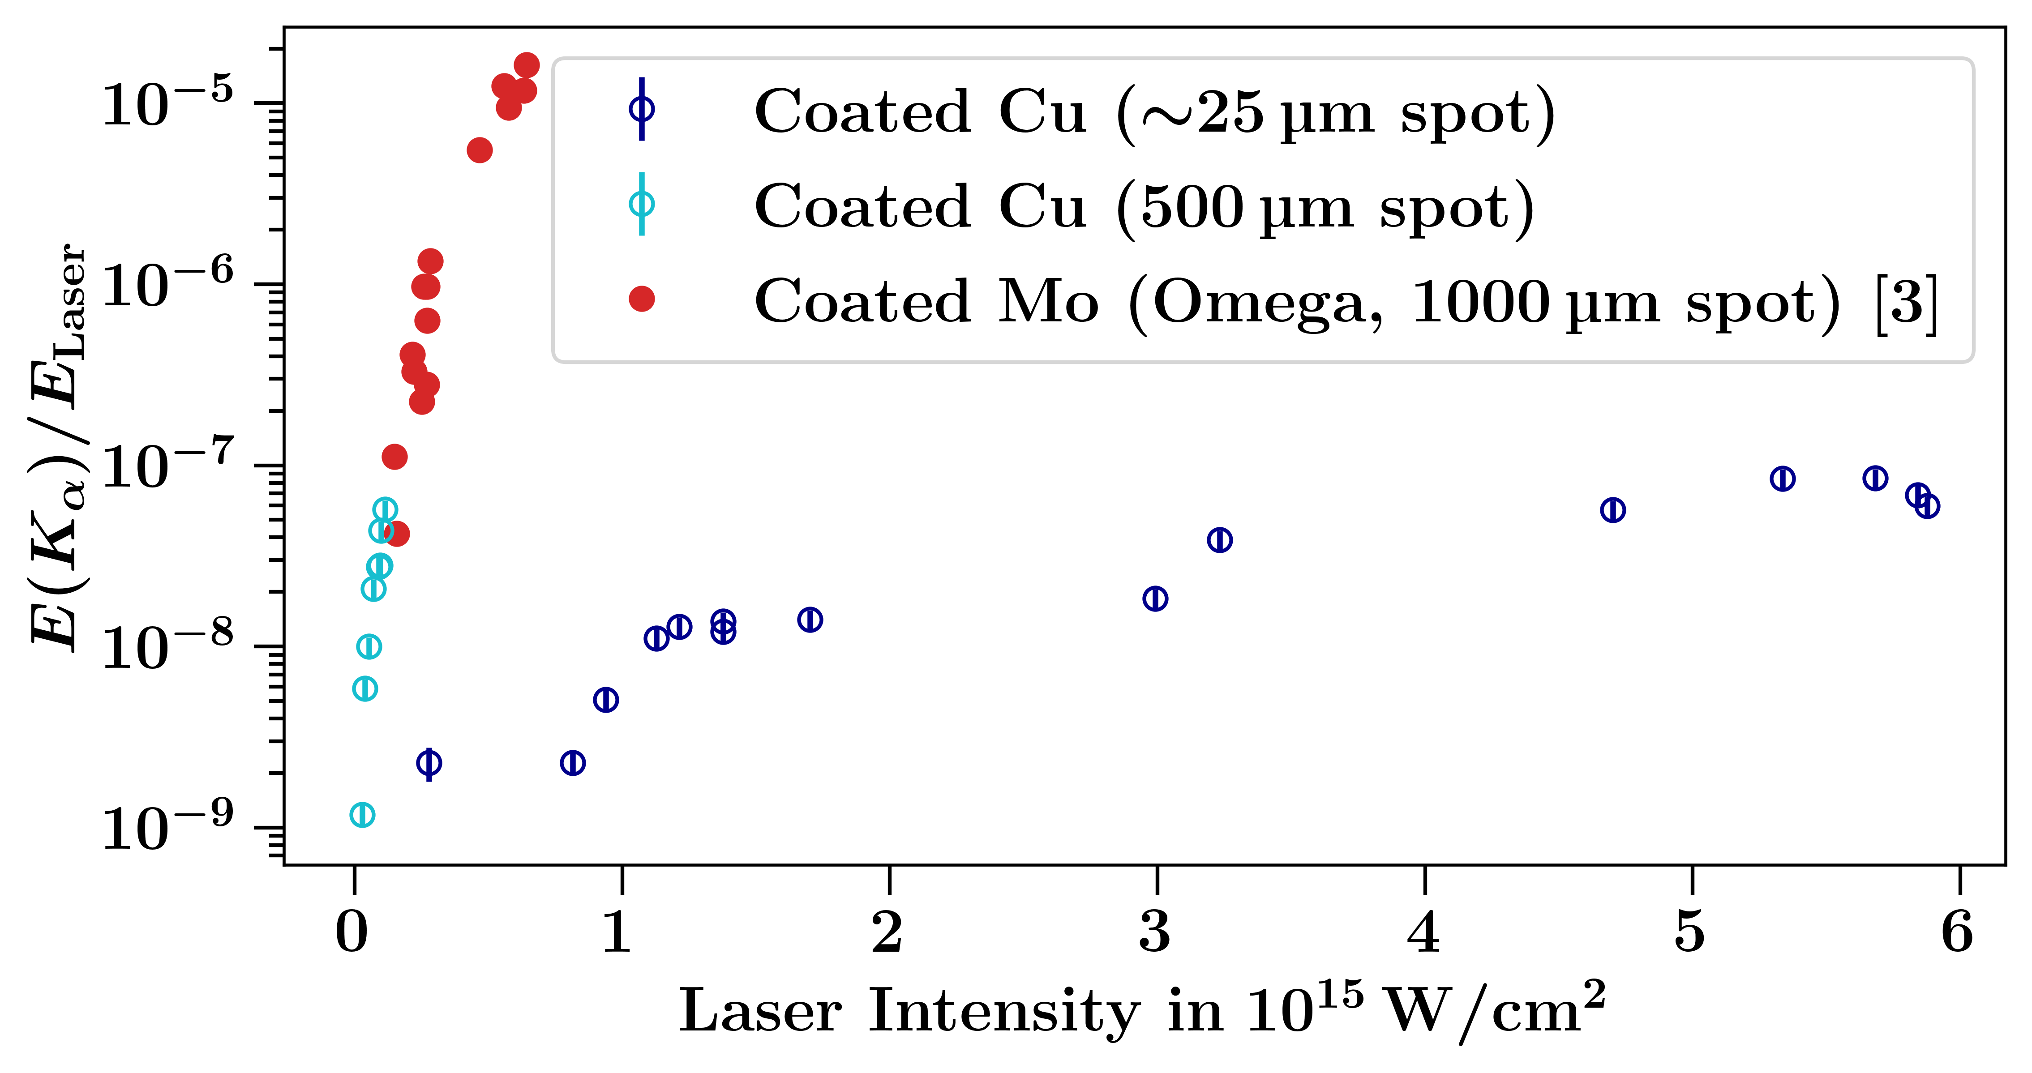
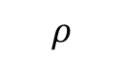
Two-Plasmon Decay Offers Potential for Generation of K_{α} Emission via Fast Electrons
$$ρ$$
K_{α} line
[1]:
Parametric instability of two-plasmon decay (TPD) to produce fast electrons
TPD stronger in low-Z material [1], but high-Z material for high E needed
Use coated target design [2]
J.F. Myatt et al. (2013), Phys. Plasmas 20
I
[2]:
S. Le Pape et al. (2019), High Energy Density Phys. 31
C₃H₆
Z
[3]:
B. Yaakobi et al. (2012), Phys. Plasmas 19
t
Z
K_{α}
e-
Exp. campaign at PHELIX
TPD enhanced by coating
Further Investigation I vs. d necessary
Notes:
3:45 (11:15)
Shortly: surprising -> variied parameters: laser spot size -> matches Omega -> promising that further optimization potential

Slide 10
Line Emission and Spectrally Broad X-Ray Sources for Different Diagnostics
Laser
X-rays
Target
Various Diagnostic Methods
X-ray diffraction */**
X-ray radiography
X-ray absorption spectroscopy, e.g. X-ray absorption near edge structure (XANES)
…
X-ray source demands
FLYCHK simulation of Al
→D. Riley (Monday)
→D. Kraus (Monday)
Line emission from x-ray source
K-edge at $ρ_{0}$
Spectrally broad x-ray source
transmission
K-edge at $0.5 ρ_{0}$
photon energy [eV]
*D. Riley‘s talk (Monday)
**D. Kraus‘ talk (Monday)
Notes:
2:45 (4:15)
diagnostics -> source
lattice structure of a crystal
only cold samples
Shortly: XRD, Radiography
(detect constructive interference of Bragg reflected X-rays)

Slide 11
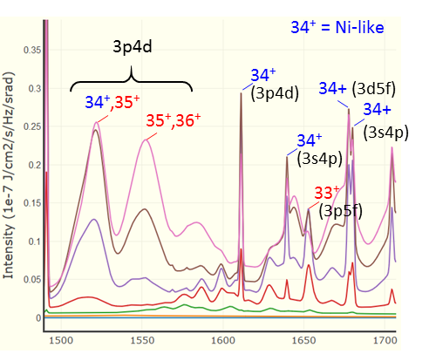

Typical Quasi-Continuum Spectra not Optimal for Detecting Fine Absorption Features
Typical creation of spectrally broad emission
High-energy ns-laser (PHELIX: 200J) focused on rare-earth target (e.g. Sm, Dy, Yb)
∼100eV-keV hot plasma
Line emission from transitions to M-shell
Quasi-continuum spectra
XANES spectroscopy (detecting fine absorption features) difficult with ragged spectra
Idea: Continuum spectra from free-bound transitions of electrons (recombination)
Sm Spectra (FLYCHK Simulation)
0.3
T_{e} [eV]
100
0.2
Intensity in a.u.
.
.
.
0.1
700
0
1500
1550
1600
1650
1700
Photon Energy in eV
Sm Spectra (Experiment at GSI)
1.2
H. Karadas, GSI, 2019
XANES of 0.8μm Alu
1.0
Data from CXRO
1
0.8
0.8
Intensity in a.u.
Transmission
0.6
0.6
0.4
0.4
0.2
→short range order
1500
1500
1550
1600
1650
1700
1550
1600
1650
1700
Photon Energy in eV
Photon Energy in eV
Notes:
Samarium, Dysprosium, Ytterbium
2:15 (13:30)

Slide 12
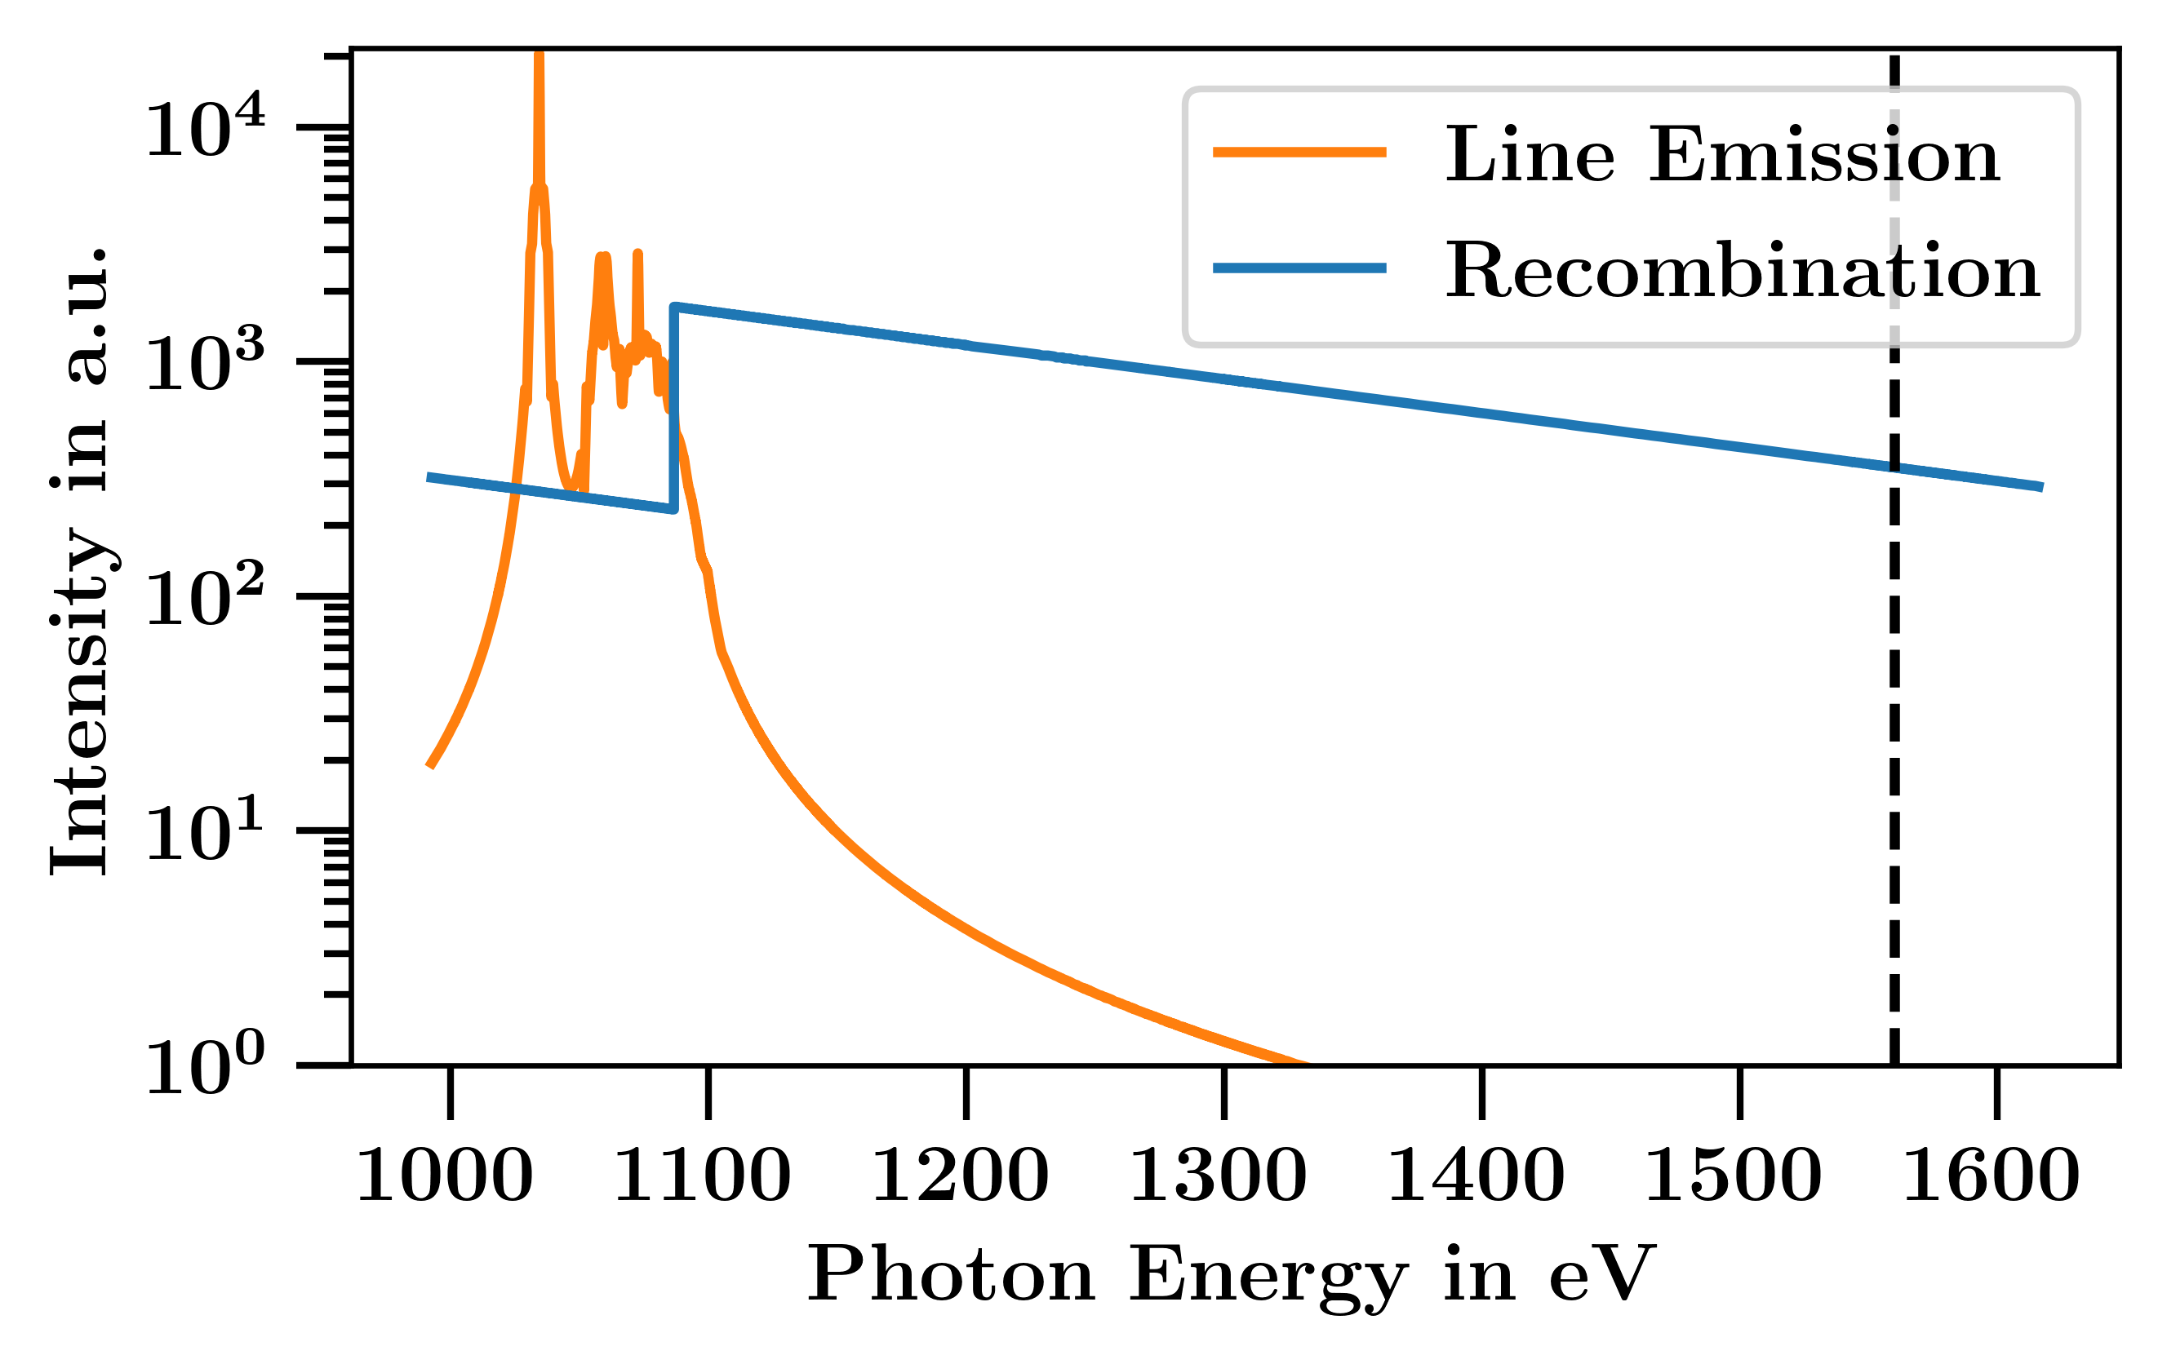
Recombination Spectra of Fluorine to be Tested in 2023 with PHELIX
Recombination
E_{kin}
Krygier et al. [4] reported on strong recombination spectra from hydrogen-like Ti (at NIF)
Adaption to PHELIX parameters and for XANES spectroscopy of Al (Al K-edge at 1560 eV)
Test Teflon C₂F₄ as laser target → F plasma
Granted PHELIX beam time for 2023 (in cooperation with Peking University, IMP/CAS Lanzhou and Xi'an JiaoTong University)
E_{b}
E
Z
E = E_{kin} + E_{b}
T_{e} [eV]
bb
fb
ff
100
Simulated (FLYCK) Spectra of F plasma (T_{e} = 300 eV)
200
H_{γ}
300
400
Al K-edge
[4]: Krygier et al. (2020), Appl. Phys. Lett. 117
Notes:
2:00 (15:30)
Shortly: Spectrum of F
(Also test Na-compound targets (for emission around Si K-edge at 1840 eV))

Slide 13
Summary
Ion beam
X-rays
Diagnostic Methods
X-ray diffraction
X-ray radiography
X-ray absorption spectroscopy, e.g. X-ray absorption near edge structure (XANES)
Laser
Detector
Line emission from x-ray source
target
sample
Spectrally broad x-ray source
Line Emission
Need for higher photon energies
Tested coated targets to produce fast electrons via TPD
Spectrally broad x-ray source
Need for real (no quasi) continuum emission
Recombination spectra to be tested 2023
H_{γ}
Simulated (FLYCK) Spectra of F plasma (T_{e} = 300 eV)
Further Investigation I vs. d necessary
Al K-edge
Notes:
1:00 (16:30)

Slide 14



Acknowledgements
Ion beam
X-rays
Thanks to
P. Neumayer, V. Bagnoud, Zs. Major, X. Yu, S. Zähter
S. LePape
The PHELIX team
Laser
Detector
target
sample
Notes:
0:15 (16:45)
Thanks to everyone involved in the experiments I‘ve shown you and thank you for your attention.

Slide 15
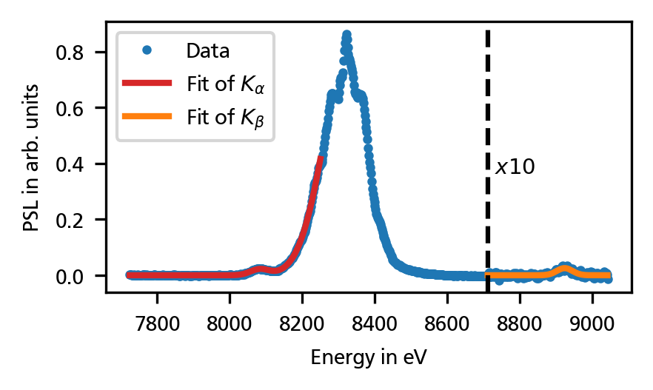
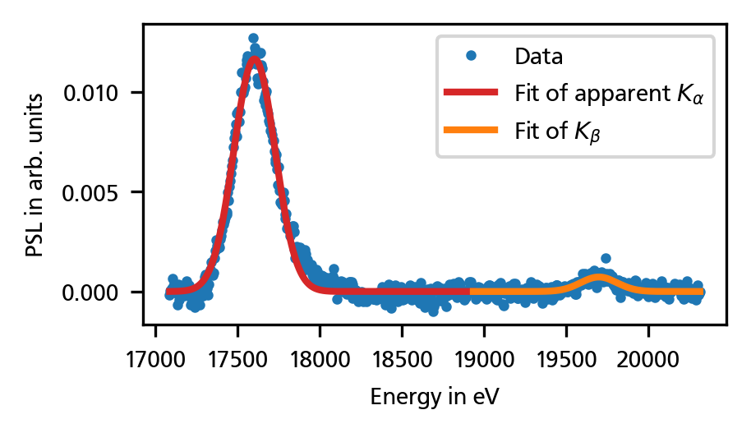
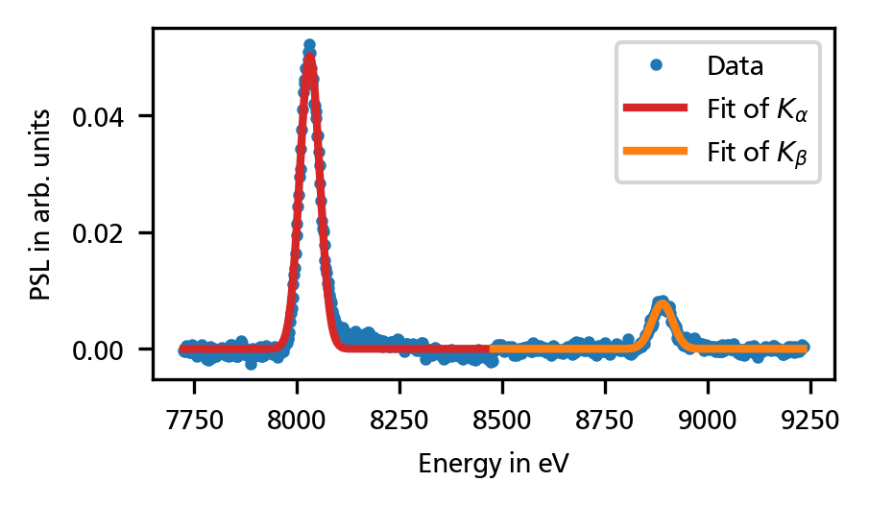
Line Emission in TPD Experiment
Ion beam
Laser
X-rays
Detector
target
Bare Cu
sample
Bare Mo
Coated Cu
Notes:
0:15 (16:45)
Thanks to everyone involved in the experiments I‘ve shown you and thank you for your attention.

Slide 16
Line Emission and Spectrally Broad X-Ray Sources for Different Diagnostics
Detector
Ion beam
sample
Laser
X-rays
Detector
Detector
Detector
Detector
target
Results for cold samples
XANES of 0.8μm Alu
(111)-reflection
(diamond)
Various Diagnostic Methods
X-ray diffraction */**
X-ray radiography
X-ray absorption spectroscopy, e.g. X-ray absorption near edge structure (XANES)
…
X-ray source demands
FLYCHK simulation of Al
→D. Riley (Monday)
→D. Kraus (Monday)
1.0
Radiograph
Test object
Data from CXRO
Line emission from x-ray source
K-edge at $ρ_{0}$
0.8
Spectrally broad x-ray source
Transmission
transmission
K-edge at $0.5 ρ_{0}$
0.6
K-shell ionization edge of Al
2mm
0.4
photon energy [eV]
step wedge
(polycarbonate)
→short range order
needle
(steel)
1500
1550
1600
He_{β}
1650
1700
*D. Riley‘s talk (Monday)
**D. Kraus‘ talk (Monday)
He_{α}
He_{γ}
Energy [eV]
H. Karadas, GSI, 2019
Zs. Major et al., GSI HED Report, 2019
Notes:
2:45 (4:15)
diagnostics -> source
lattice structure of a crystal
only cold samples
Shortly: XRD, Radiography
(detect constructive interference of Bragg reflected X-rays)

Slide 17

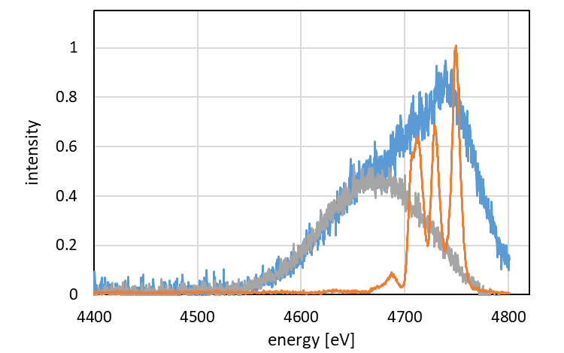
Line Emission and Continuum X-Ray Sources for Different Diagnostics
Detector
Detector
Ion beam
Ion beam
Ion beam
Ion beam
Ion beam
X-rays
Laser
X-rays
Laser
X-rays
X-rays
Laser
X-rays
Laser
Laser
X-rays
Laser
Detector
Detector
Detector
Detector
Detector
target
target
target
target
target
target
sample
sample
sample
sample
sample
Results for cold samples
(111)-reflection
(diamond)
X-ray source demands
Various Diagnostic Methods
X-ray diffraction */**
X-ray Thomson scattering **
X-ray radiography
X-ray absorption near edge structure (XANES) spectroscopy
FLYCHK simulation of Al
1.0
→D. Riley (Monday)
→D. Kraus (Monday)
source spectrum
scattering (plastic)
scattering (diamond)
Radiograph
Test object
Line emission from x-ray source
0.8
K-edge at $ρ_{0}$
Transmission
transmission
K-shell ionization edge
0.6
K-edge at $0.5 ρ_{0}$
Continuum x-ray emission
0.4
2mm
photon energy [eV]
step wedge
(polycarbonate)
1500
1550
1600
1650
1700
needle
(steel)
Energy [eV]
*D. Riley‘s talk (Monday)
**D. Kraus‘ talk (Monday)
He_{α}
He_{β}
He_{γ}
H. Karadas, GSI, 2019
Zs. Major et al., GSI HED Report, 2019
Notes:
4:30 (6:00)

Slide 18
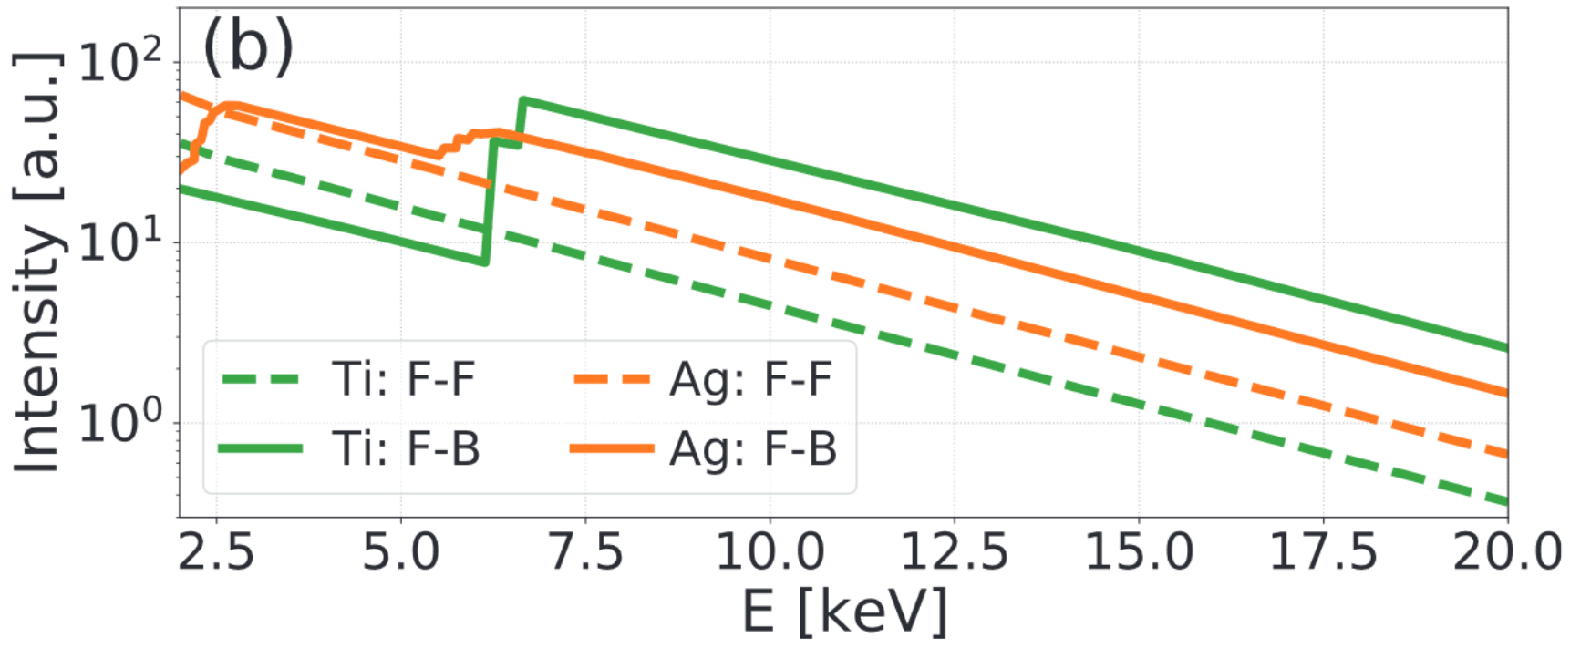
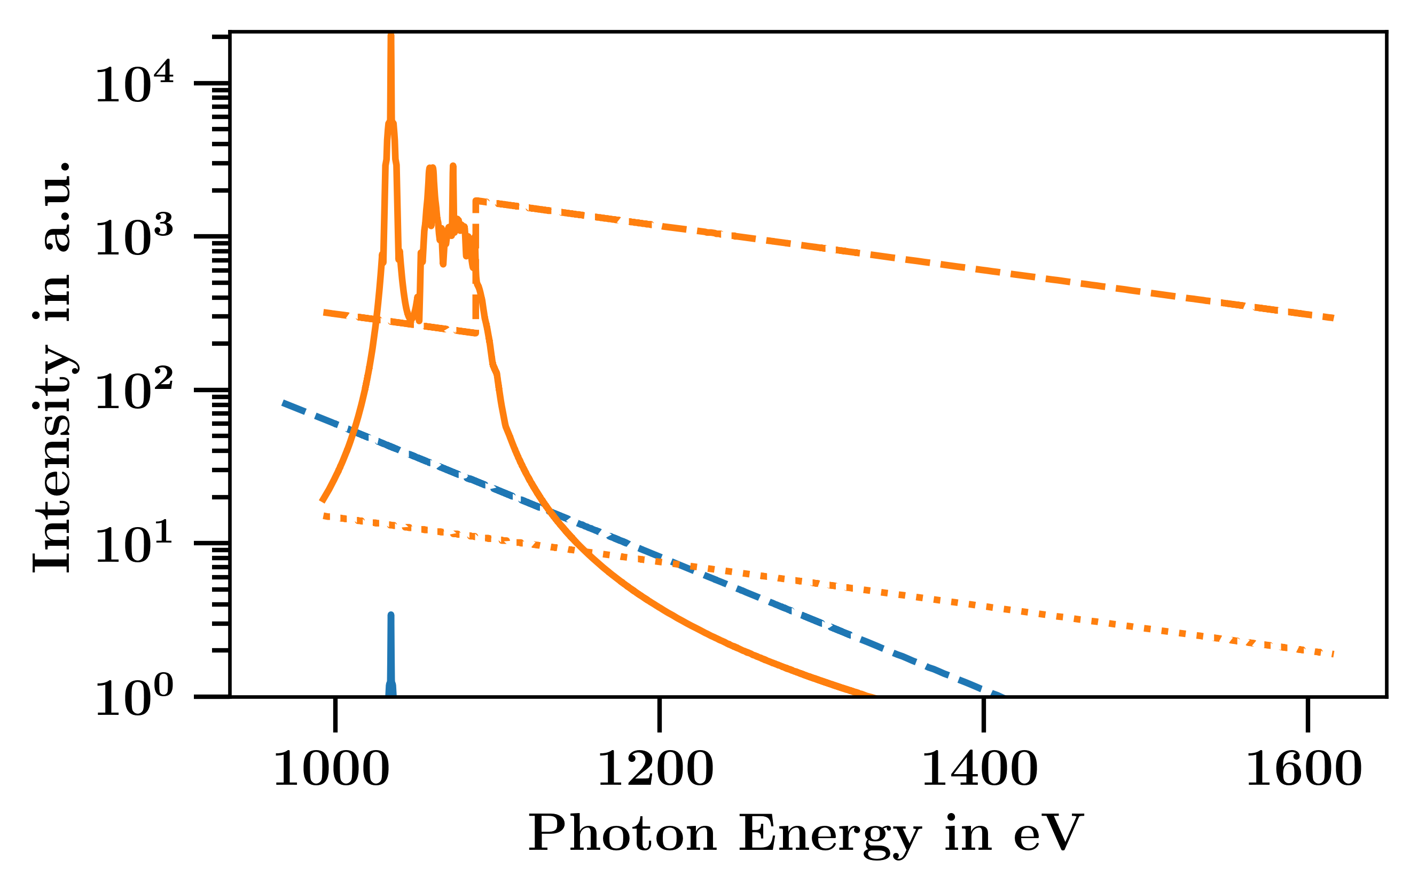
Recombination Spectra of F to be Tested in 2023 with PHELIX
* Appl. Phys. Lett. 117, 251106 (2020)
Krygier et al.* report on strong recombination spectra from hydrogen-like Ti at NIF
Recombination
E_{kin}
Simulated Spectra from *
E_{b}
E
Z
T_{e} [eV]
bb
fb
ff
Simulated (FLYCK) Spectra of F plasma
T_{e} [eV]
bb
fb
ff
E = E_{kin} + E_{b}
100
E_{b}
100
200
300
H_{γ}
300
Adaption to PHELIX parameters and to XANES of Al (Al K-edge at 1560 eV)
Granted PHELIX beamtime for 2023 (in cooperation with Wei Kang et al.) to test F plasma (from PTFE C₂F₄)
400
Al K-edge
Notes:
3:30 (18:30)
Also test Na-compound targets (for emission around Si K-edge at 1840 eV)

Slide 19
Recombination Spectra of F to be Tested in 2023 with PHELIX
* Appl. Phys. Lett. 117, 251106 (2020)
Recombination
E_{kin}
Krygier et al.* reported on strong recombination spectra from hydrogen-like Ti (at NIF)
Adaption to PHELIX parameters and for XANES spectroscopy of Al (Al K-edge at 1560 eV)
Test Teflon C₂F₄ as laser target → F plasma
Granted PHELIX beam time for 2023 (in cooperation with Peking University, IMP/CAS Lanzhou and Xi'an JiaoTong University)
E_{b}
E
Z
E = E_{kin} + E_{b}
T_{e} [eV]
bb
fb
ff
Simulated (FLYCK) Spectra of F plasma
100
T_{e} [eV]
bb
fb
ff
200
100
H_{γ}
300
300
400
Al K-edge
Notes:
2:30 (17:30)
Also test Na-compound targets (for emission around Si K-edge at 1840 eV)

